Slide 1
HSIL HACKATHON 2026 — APRIL 11
Magic Gene

Slide 2
HSIL HACKATHON 2026 — APRIL 11
1/20
1/2000
AU$5M
Magic Gene
people affected by genetic diseases
people worldwide
affected by IRDs
per person per lifetime
in healthcare costs
AI workflow assistant for
inherited retinal disease
6–8
from genetic test to
patient report — today.
Clinicians are drowning
in manual data wrangling.
months
Addresses HSIL Challenges
#1 EHR Analysis
#4 Fragmentation of Care
The Pipeline — where Magic Gene sits:
#6 Healthcare Worker Shortage
1
2
3
Variant
Filtering
→
Report
Generation
→
Triage &
Treatment
Post-Hackathon Roadmap
Sequencing →
relevant variants
Genetic + clinical
→ draft report
Severity ranking →
next steps
→ Expand step 1 variants
→ Step 2: Patient report generation = today
ROADMAP
⭐ HACKATHON FOCUS
ROADMAP
💊 An approved gene therapy exists (Luxturna/voretigene neparvovec). Patients aren't receiving it fast enough. The pipeline is broken — Magic Gene fixes Step 2 today.
→ Expand step 3 usage in triage and treatment

Slide 3
HSIL HACKATHON 2026 — APRIL 11
Go-To-Market Strategy
Magic Gene
Niche: inherited retinal diseases
Clear mutation-disease correlation with available gene therapy
Market: genetic testing laboratories, hospitals, eye clinics
Users: molecular biologists, geneticists
Pilot: one hospital department with de-identified data → validate data and publish for transparency
Expand: other genes, other diseases, other departments such as oncology, cardiology
Integrate patient history clinical data with variant testing
Competitive Landscape
Lookup databases such as Franklin, record platforms for electronic medical records
Business Model
Business to business
Subscription/Licensing

Slide 4
HSIL HACKATHON 2026 — APRIL 11
Magic Gene

Slide 6
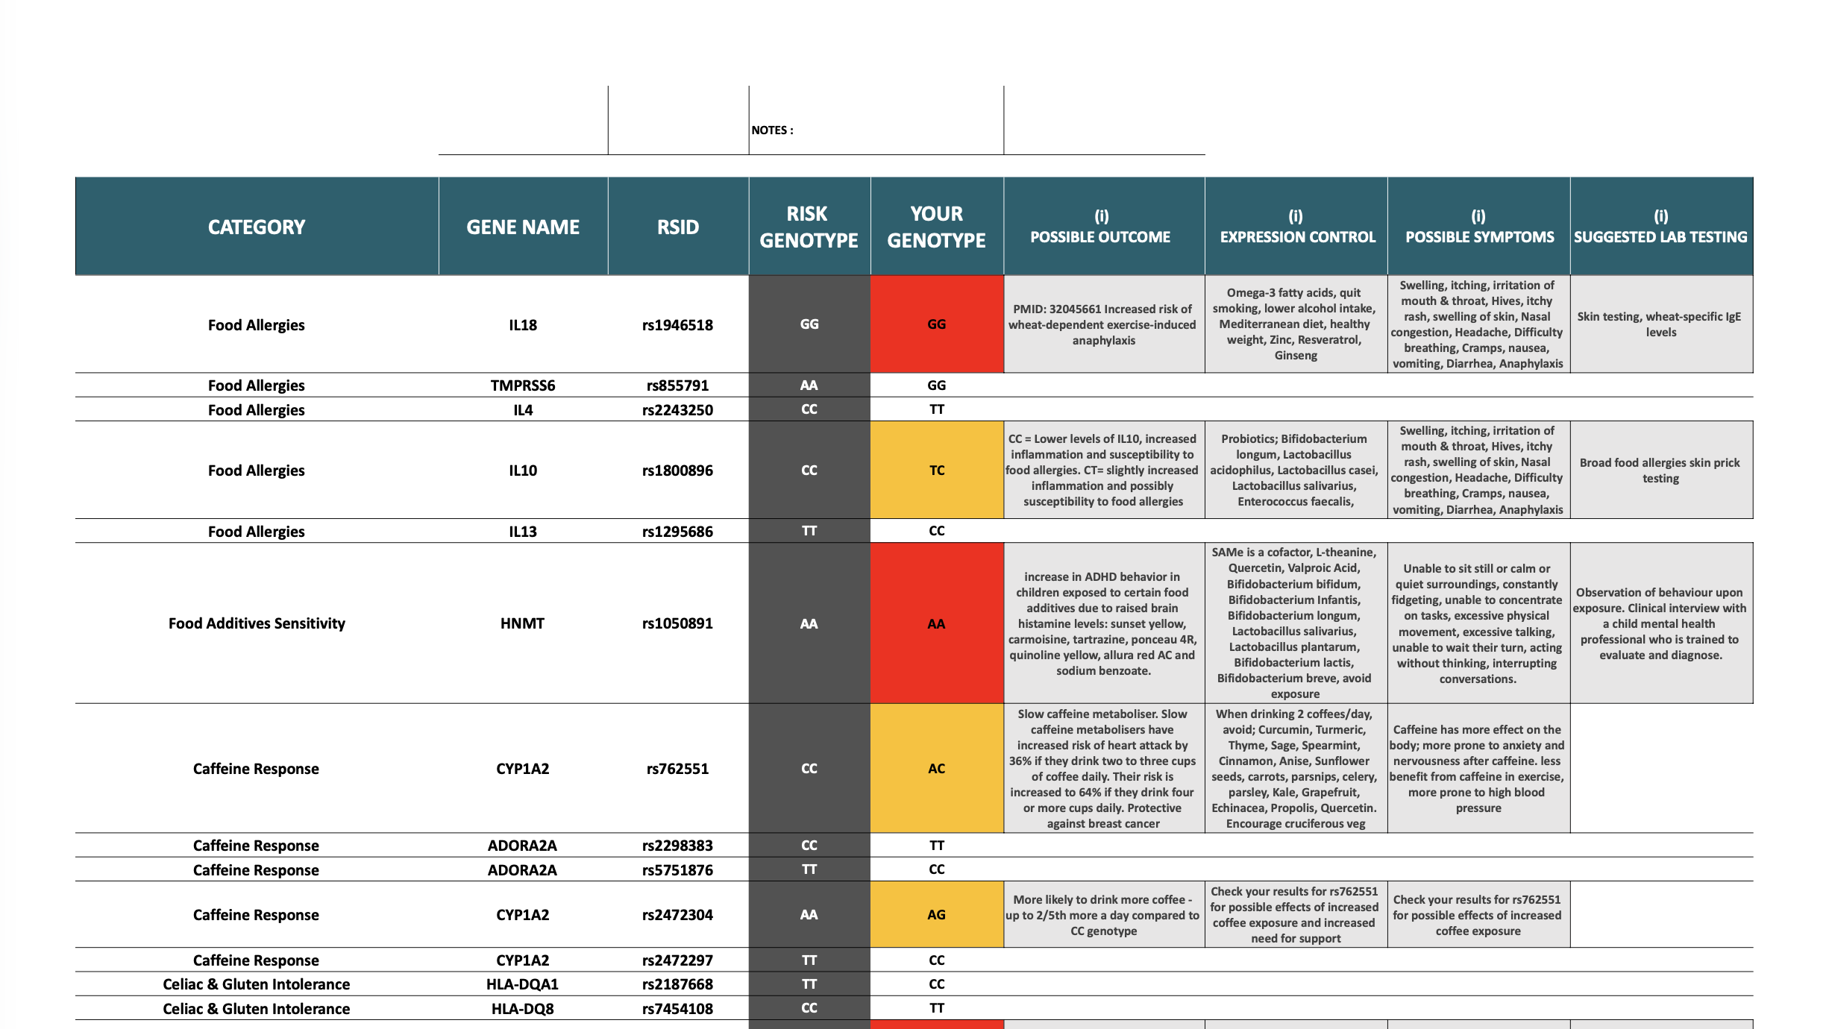

Slide 7
6–8
from genetic test to
patient report — today.
Clinicians are drowning
in manual data wrangling.
HSIL HACKATHON 2026 — APRIL 11
Magic Gene
months
AI workflow assistant for
inherited retinal disease
1/2000
AU$5M
1/20
people worldwide
affected by IRDs
per person per year
in healthcare costs
people affected by genetic diseases
Addresses HSIL Challenges
#1 EHR Analysis
#4 Fragmentation of Care
The Pipeline — where Magic Gene sits:
#6 Healthcare Worker Shortage
1
2
3
Variant
Filtering
→
Report
Generation
→
Triage &
Treatment
Post-Hackathon Roadmap
Sequencing →
relevant variants
Genetic + clinical
→ draft report
Severity ranking →
next steps
→ Step 1: AI variant filtering from sequencing data
ROADMAP
⭐ HACKATHON FOCUS
ROADMAP
→ Step 2: Patient report generation ← today
💊 An approved gene therapy exists (Luxturna/voretigene neparvovec). Patients aren't receiving it fast enough. The pipeline is broken — Magic Gene fixes Step 2 today.
→ Step 3: AI triage & treatment prioritisation

Slide 8
DEMO
DEMO
Magic Gene in action — plain language query → patient records → AI draft → clinician sign-off
app.magicgene.health/patient/RAVI-DEMO-003
A
Plain language query
Magic Gene
🔍 "Show me Ravi's last cardiology referral, recent bloods and genomic report"
B
Relevant records surfaced instantly — highlighted
C
AI drafts the letter using patient's own records — clinician edits, not writes
🔍 Search
Patient Record — Ravi (RAVI-DEMO-003)
✍️ AI Draft — Discharge Letter
Cardiology Referral
Mar 2026
Dear Dr. Okonkwo,
Re: Ravi [DOB: 12/03/1998] | RAVI-DEMO-003
I am writing regarding the above patient who attended our Ophthalmology clinic on 14 March 2026 for review of their inherited retinal dystrophy.
Genetic testing has identified an RPE65 variant (p.Asp87Gly) of uncertain significance. ERG findings confirm severely attenuated scotopic responses (b-wave ~18 µV; ref >150 µV), consistent with rod-predominant dysfunction. OCT shows outer nuclear layer thinning (~42 µm).
Referral to the gene therapy service has been initiated. Patient may be a candidate for voretigene neparvovec (Luxturna) if biallelic pathogenic variants are confirmed.
Please review the attached genomic report for further detail.
📋 Patients
RPE65 Genomic Report
Feb 2026
📄 Reports
Blood Panel
Jan 2026
✏️ Drafts
ERG Results
Jan 2026
⚙️ Settings
Ophthalmology Notes
Dec 2025
Discharge Summary
Nov 2025
GP Referral Letter
Oct 2025
✓ Review & Sign Off
✎ Edit Draft
A
Clinician types plain-language query
B
Relevant records surfaced in <5 seconds
C
AI drafts discharge letter from patient data
D
Clinician reviews, edits & signs off

